Slide 1


EMC Underground: MetroLabs
MetroLabs

Slide 2
Goal
The goal of this series of labs is to provide a hands on experience in developing a Continuous Integration/Delivery pipeline to deploy an apache web server with content to servewfww up through the web server.
The tools used this lab series will be:
Github
Jenkins
Puppet
Docker
VirtualBox

Slide 3
Environment

Slide 4
Tools
Laptop
Virtualization Platform (VirtualBox)
Github.com (Source Code Control)
Puppet (Configuration Management)
Jenkins (Continuous Integration & Delivery)

Slide 5
VirtualBox
What is it?
Open Source Virtualization platform supported on multiple platforms
Windows
Linux
MacOs
Solaris
Usage
VirtualBox* will be used to create Virtual Machines (VM) on your laptop.
For the purpose of these labs, we will be creating 2 VMs, one for the Puppet Master, the second for Puppet Client
Puppet Master server configuration
RAM – 2GB
vCPU – 1
Disk – 15GB
Puppet Client configuration
RAM – 2GB
vCPU – 1
Disk – 15GB
Notes:
* If another virtualization platform is installed to create VMs it can be used, e.g. VMWare Workstation Pro :

Slide 6
VirtualBox Downloads
Download VirtualBox
http://download.virtualbox.org/virtualbox/5.1.14/VirtualBox-5.1.14-112924-Win.exe
Download Extension Pack
The Extension pack is a set of tools for better integration between host OS and the guest OS, e.g mouse integration, clipboard, sharing of disk, and others
http://download.virtualbox.org/virtualbox/5.1.14/Oracle_VM_VirtualBox_Extension_Pack-5.1.14-112924.vbox-extpack
Installation
Go to location of download and double click.

Slide 7
Ubuntu Download
Download Ubuntu
http://releases.ubuntu.com/16.04.3/ubuntu-16.04.3-server-amd64.iso?_ga=2.1221873.114368501.1505156820-1577006882.1500922026
Installation
Directions for installing Ubuntu are later in this presentation.

Slide 8
Actions to perform:
Download VirutalBox and Ubuntu 16.04 verison
Install VirtualBox
Create 2 Virtual Machines
Puppet Master (This will be the VM supporting Puppet and Jenkins Server)
Configure VirtualBox
2GB RAM
1 vCPU
15GB HDD
Install Ubuntu 16.04
Puppet Client (This VM is where the container will be deployed)
Configure VirtualBox
2GB RAM
1 vCPU
15GB HDD
Install Ubuntu 16.04
Install VirtualBox Extension Pack

Slide 9

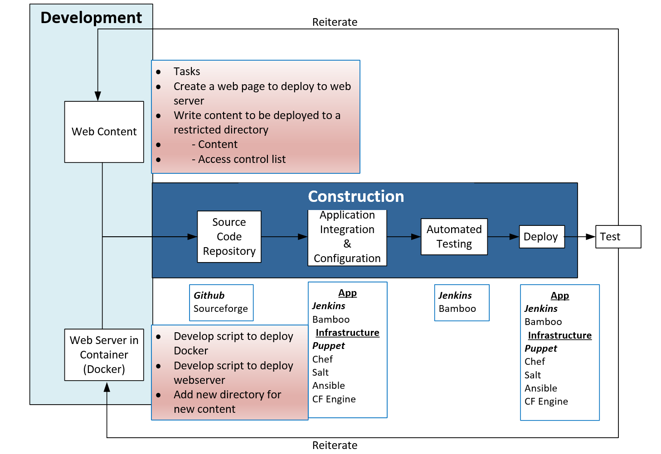

Slide 10
Environment
Internet
Virtualization Platform
(VirtualBox)
GitHub.com
Client VM
Master VM
Source Code Management
Ubuntu 16.04
Open Puppet Agent
Docker
Web Server
Content
Ubuntu 16.04
Open Puppet
Jenkins Server

Slide 11
Installation Details

Slide 12
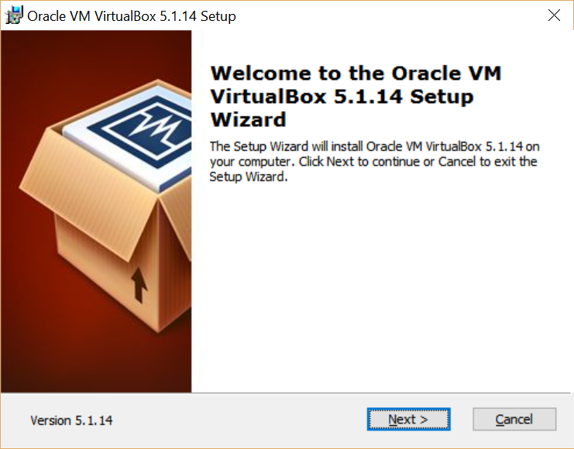
VirtualBox Installation
Click Next

Slide 13
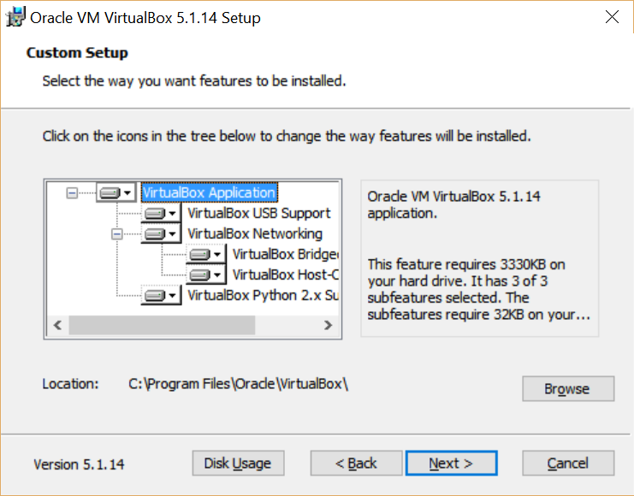
VirtualBox Installation
Choose the defaults features by clicking next.
Click Next

Slide 14
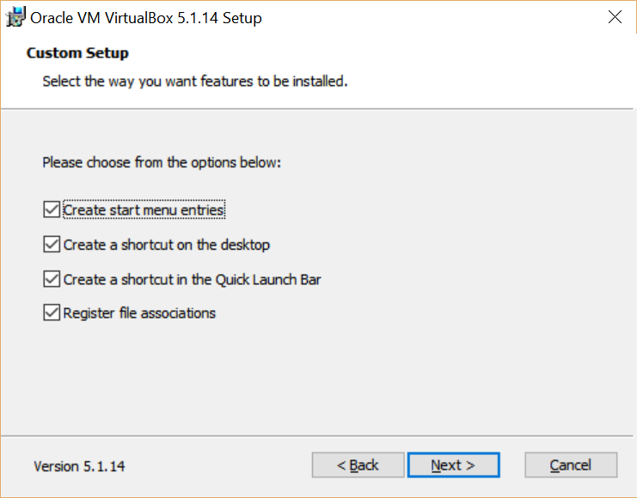
VirtualBox Installation
Choose the defaults features by clicking next or select the options that you prefer.
Click Next

Slide 15
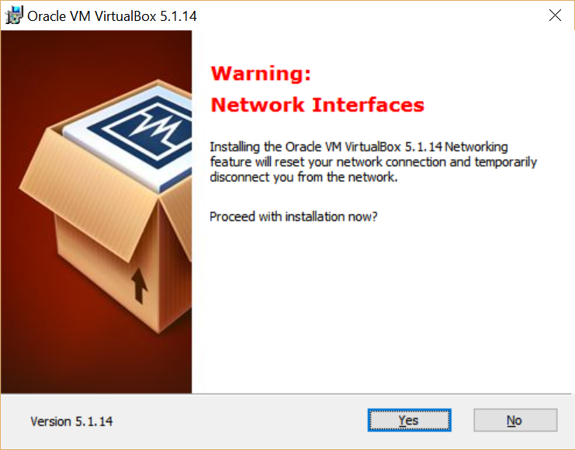
VirtualBoc Installation
Click Yes to complete VirtualBox installation
Click Next

Slide 16
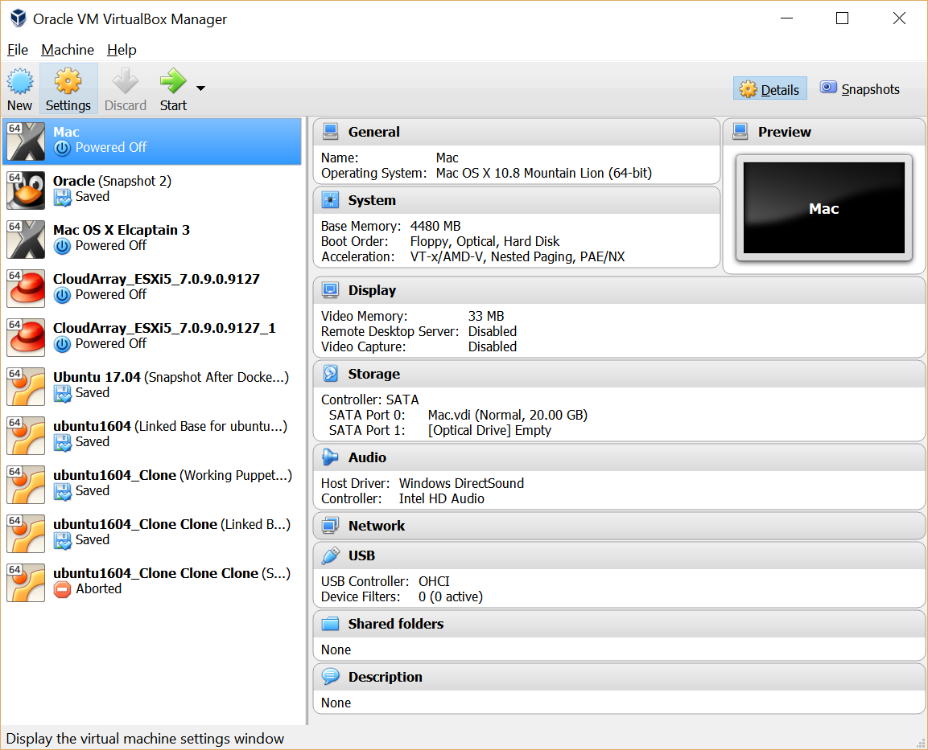
Create a VM
Click New to create a new VM
Click Next

Slide 17
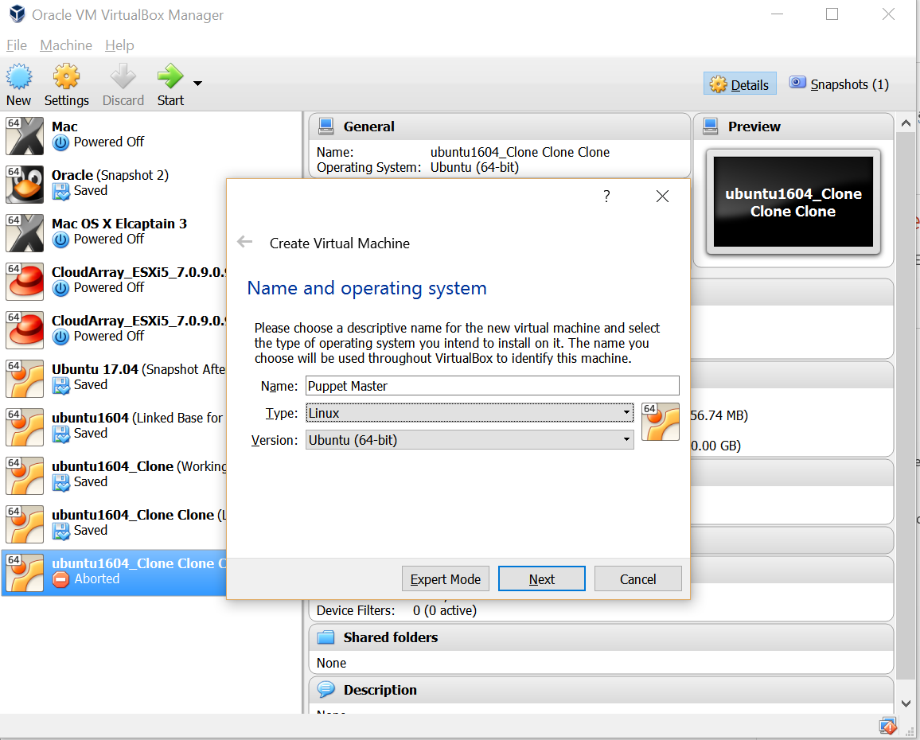
Choose VM Name
(Step 1)
Select a Name for the VM
Select Linux
Select Ubuntu (64 bit)
Then select Next
(Step 2)
Then select Next

Slide 18
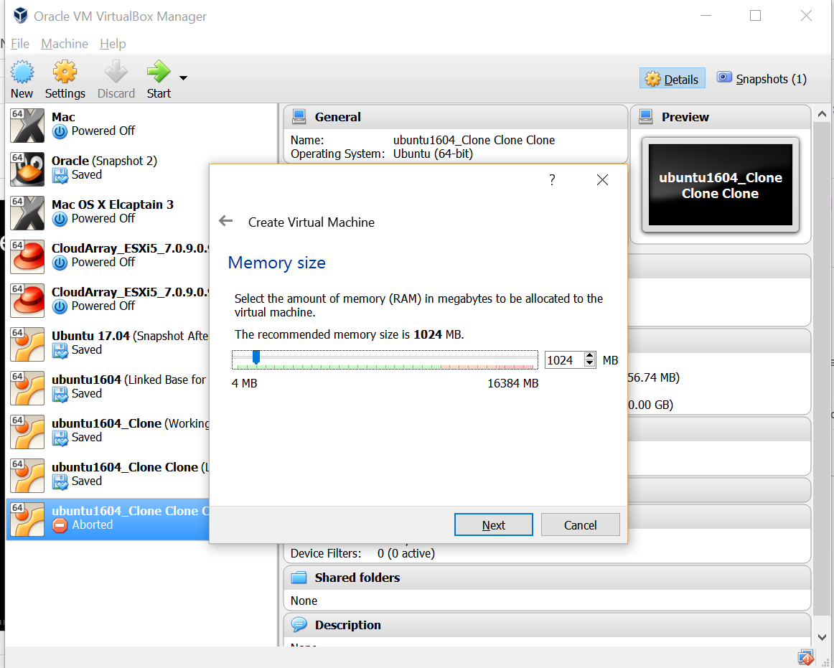
Select VM Memory (RAM)
Select 1GB of RAM
Then select Next

Slide 19
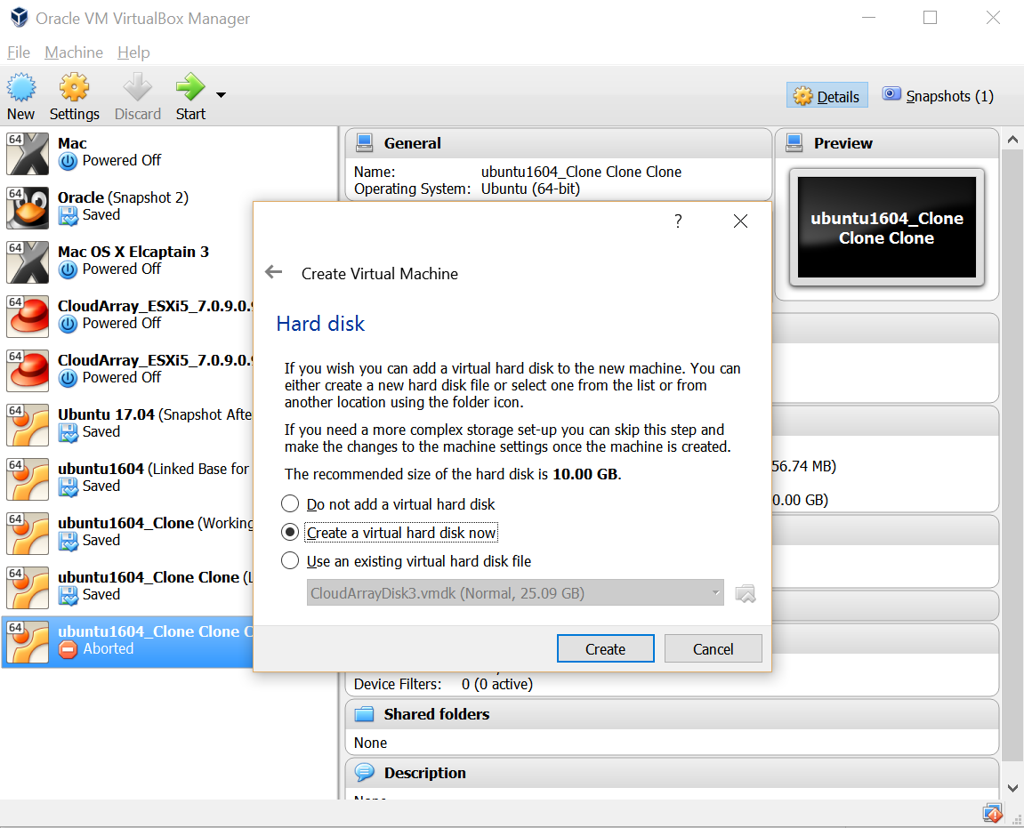
Create Hard Disk for VM
Select Create a virtual hard disk
Then select Create

Slide 20
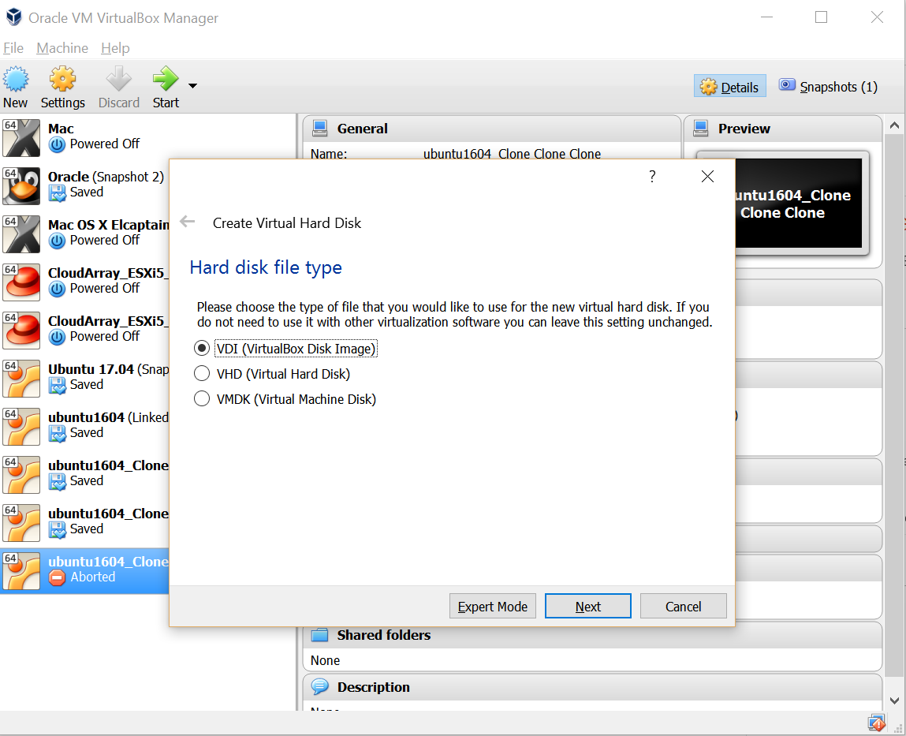
Hard Disk Type – Select VDI
Select HDD type VDI
Then select Next

Slide 21
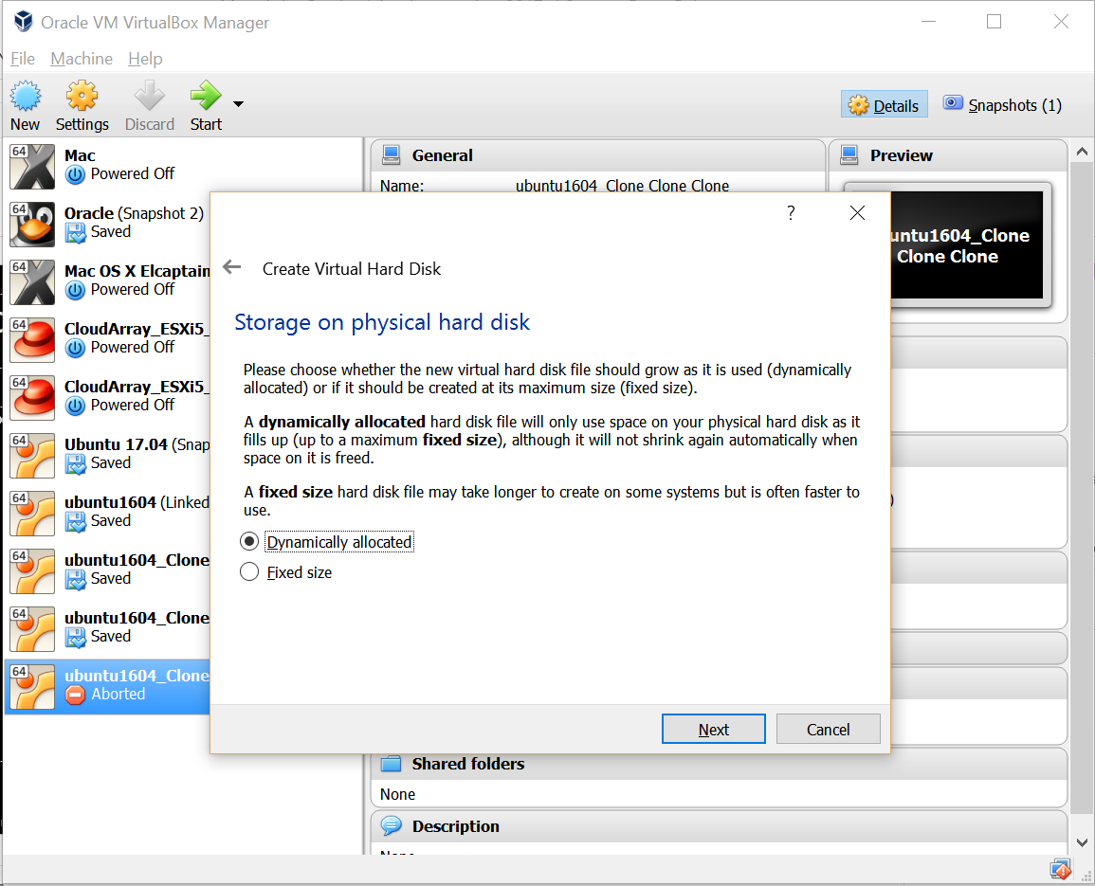
Choose Dynamic (Thin provisioning)
Select Dynamic allocated
Then select Next

Slide 22
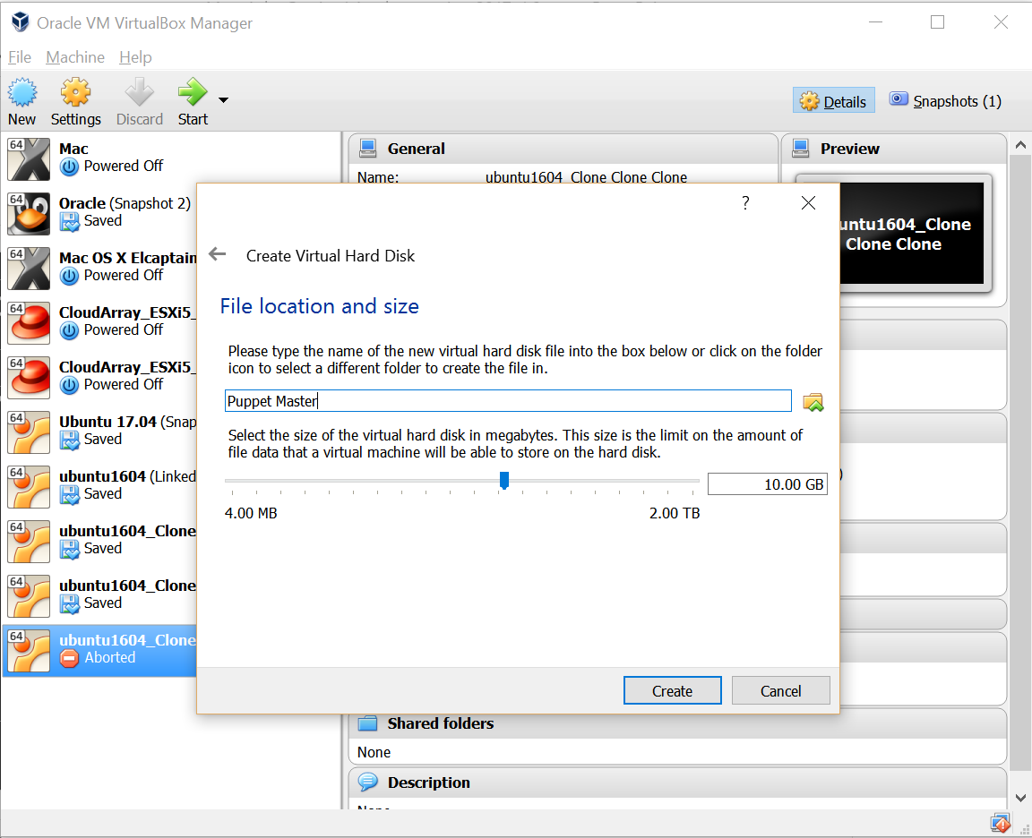
Select Hard Disk Size
Select 10GB HDD type VDI
Then select Next

Slide 23
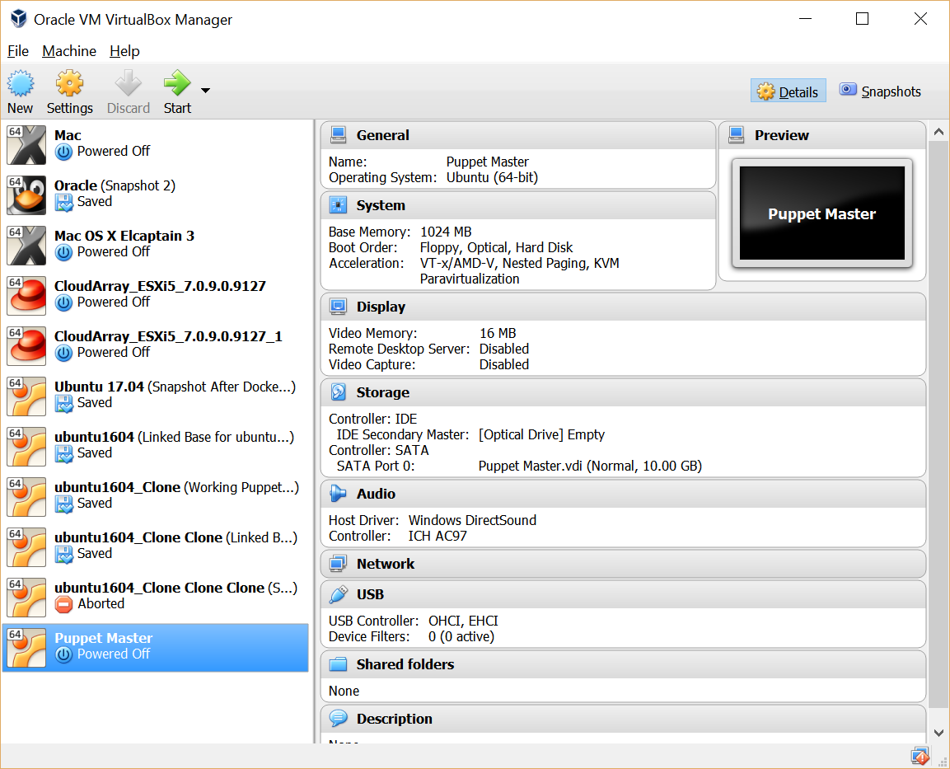
New VM Created
New VM Created

Slide 24
Repeat for Puppet Client VM

Slide 25
Install Ubuntu 16.04

Slide 26
New VM Created
Select newly created VM
Then Select Storage

Slide 27
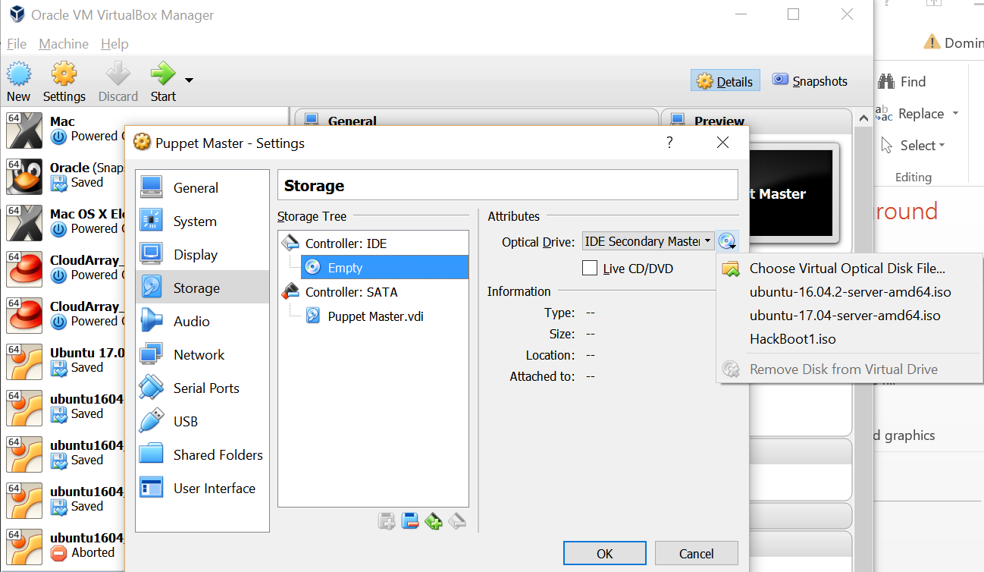
Select Empty
Then Choose Virtual Optical Disk File

Slide 28
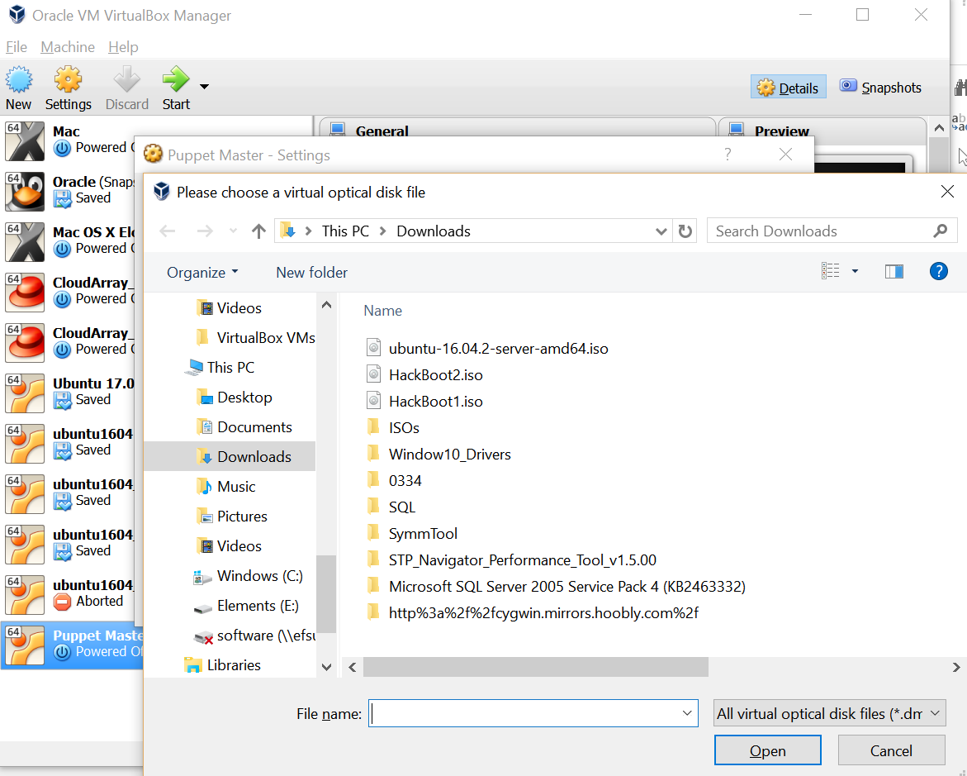
Select the downloaded image of Ubuntu
Then Select Open

Slide 29
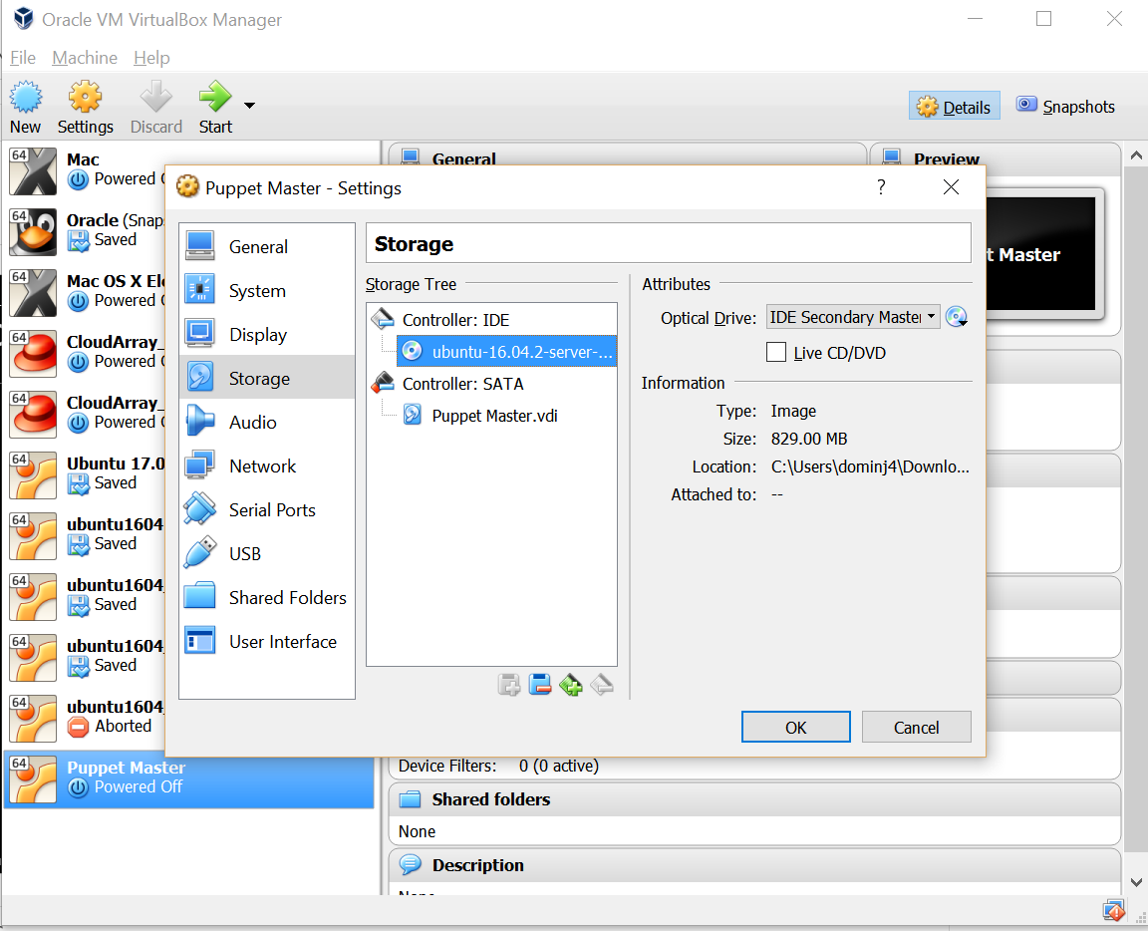
Select Ok

Slide 30
New VM Created
Select Newly Created VM
Then Start

Slide 31
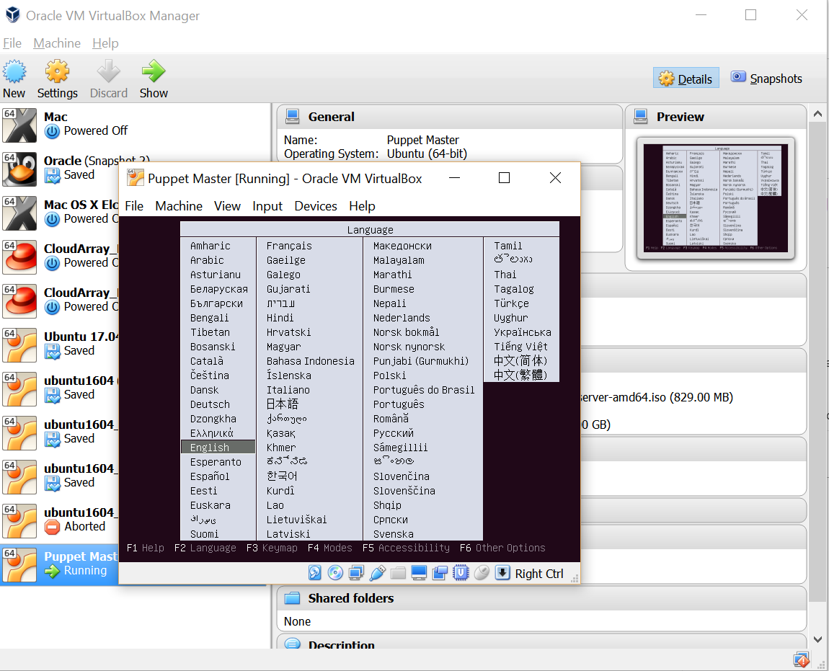
Ubuntu Installation
Select English by Pressing Enter/Return

Slide 32
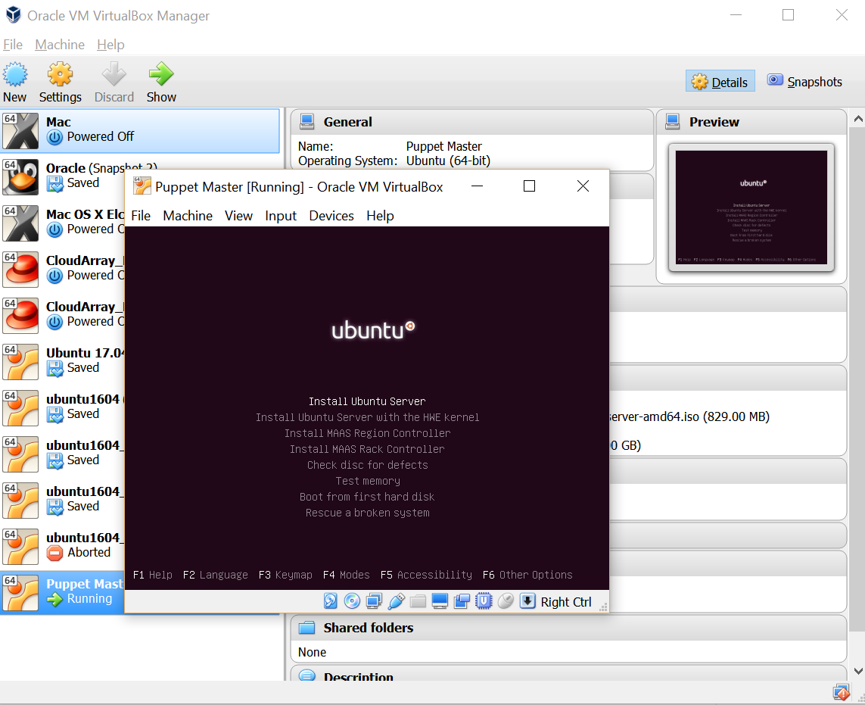
Select Ubuntu Server by Pressing Enter/Return

Slide 33
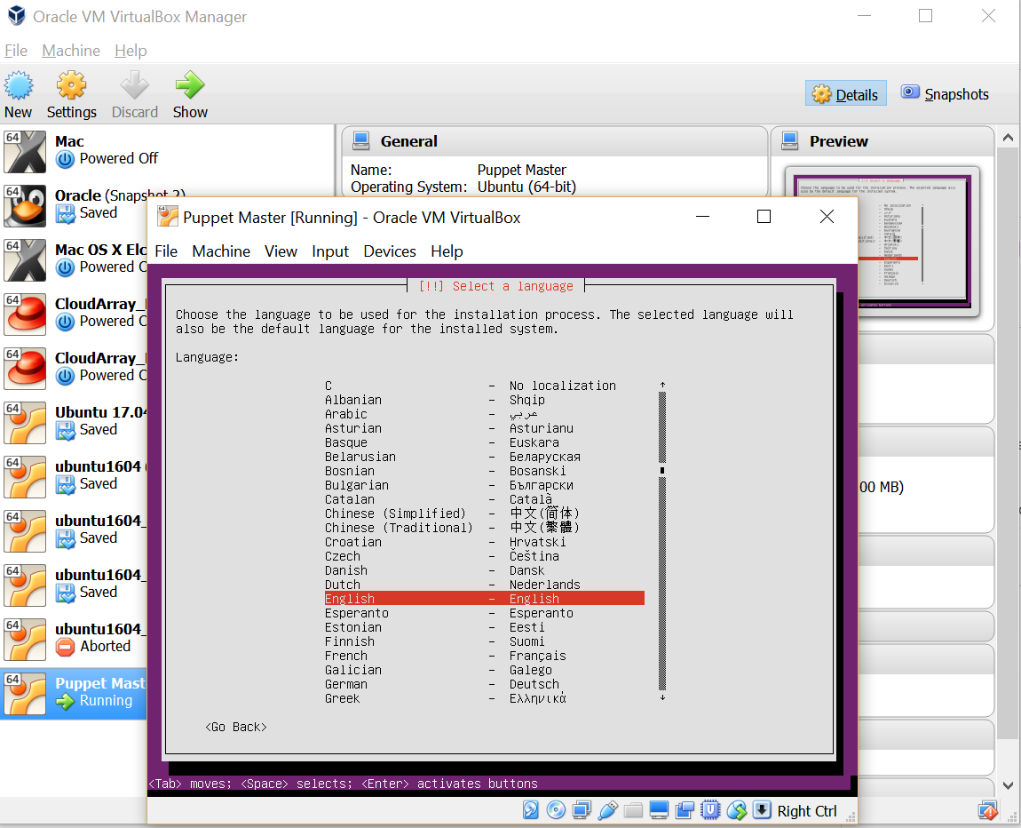
Select English by Pressing Enter/Return

Slide 34
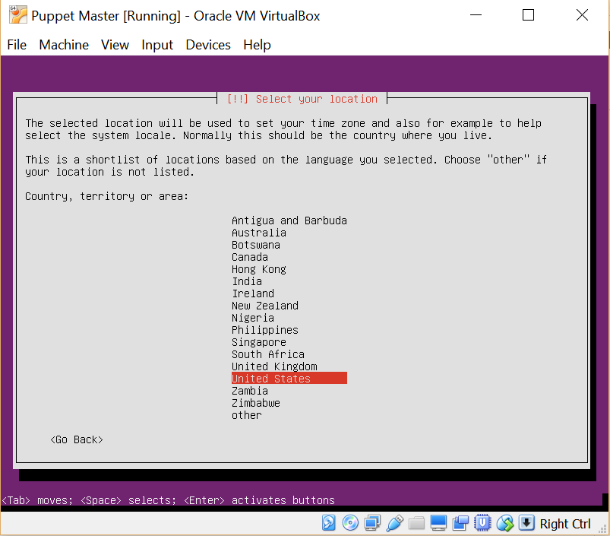
Select United Stated by Pressing Enter/Return

Slide 35
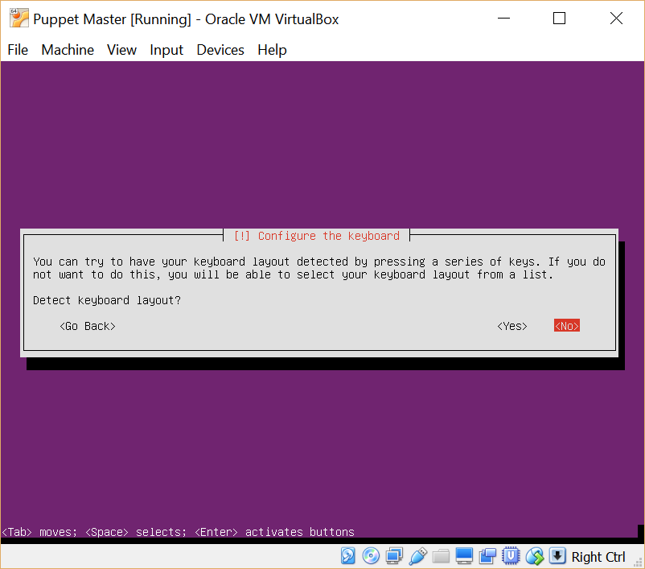
Continue by Pressing Enter/Return

Slide 36
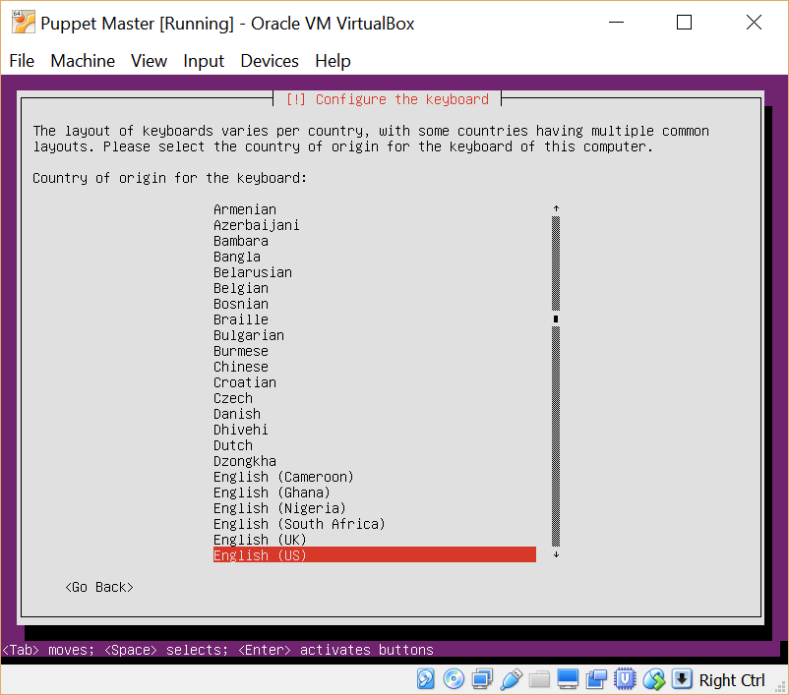
Select English by Pressing Enter/Return

Slide 37
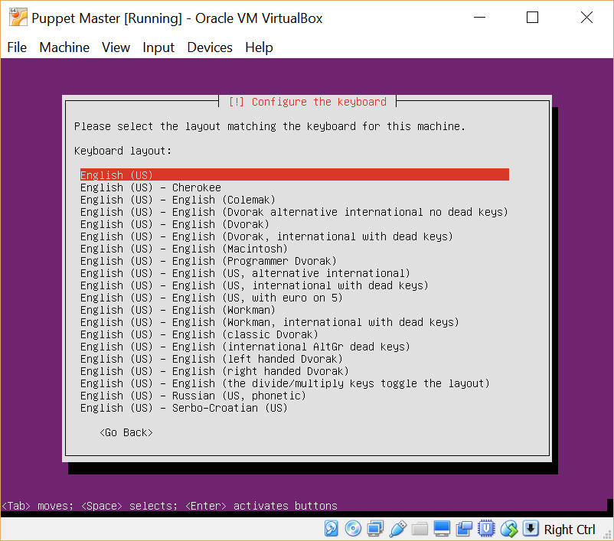
Select English by Pressing Enter/Return

Slide 38
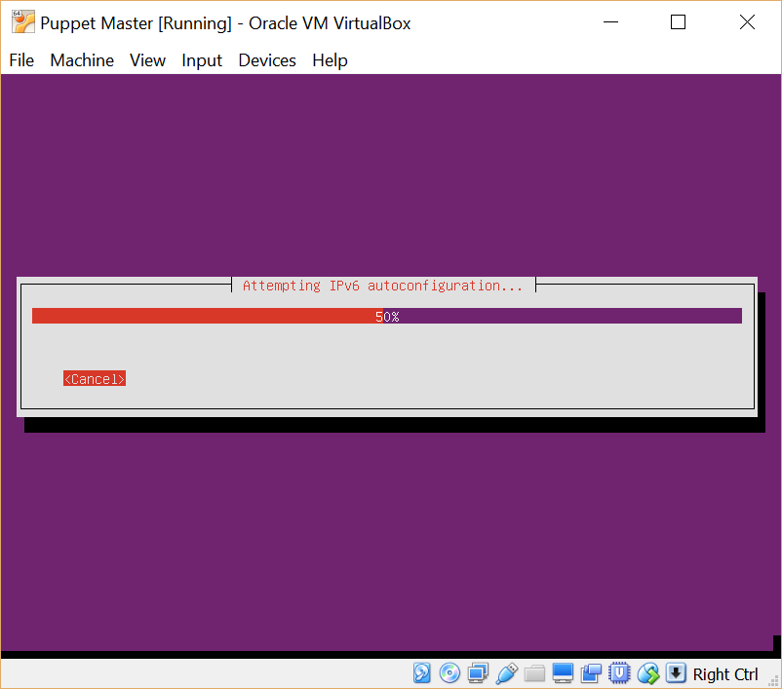
Configuration

Slide 39
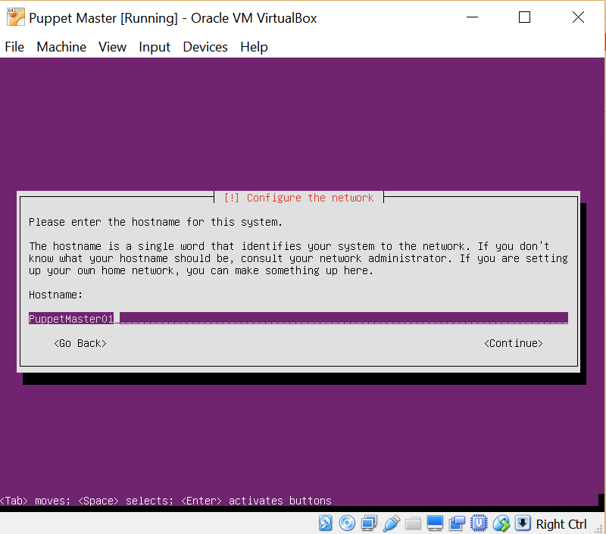
Choose a Name for the Server
Type a name for your server
Then click Continue

Slide 40
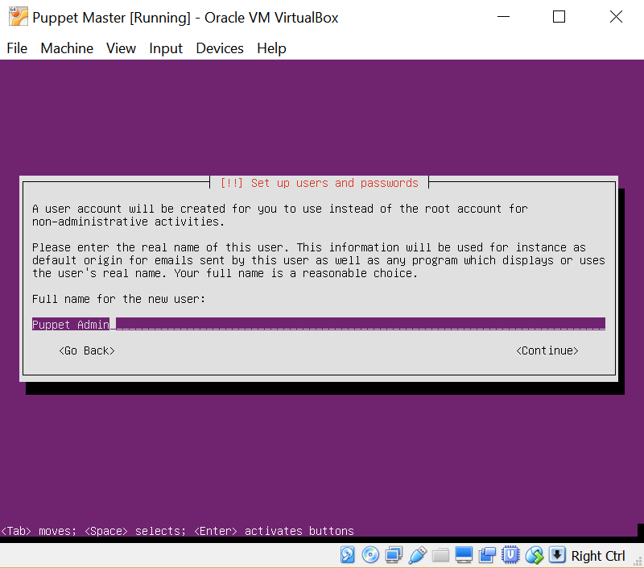
Choose the Full Name of the User
Type a full user name
Tab to Continue and Press Enter

Slide 41
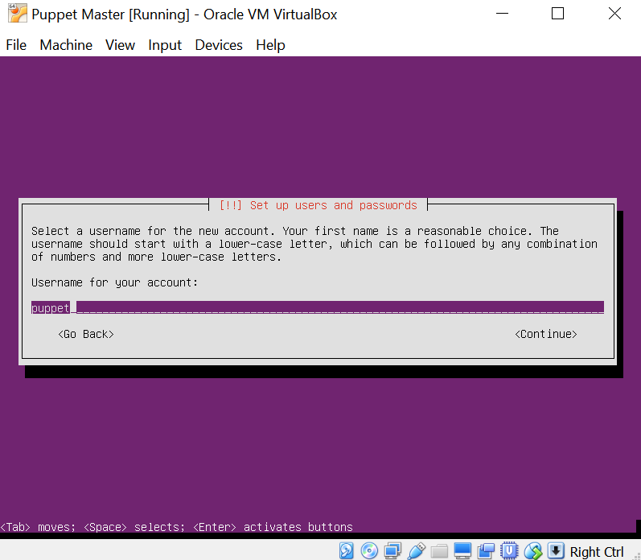
Choose a Username
Type a user name
Tab to Continue and Press Enter

Slide 42
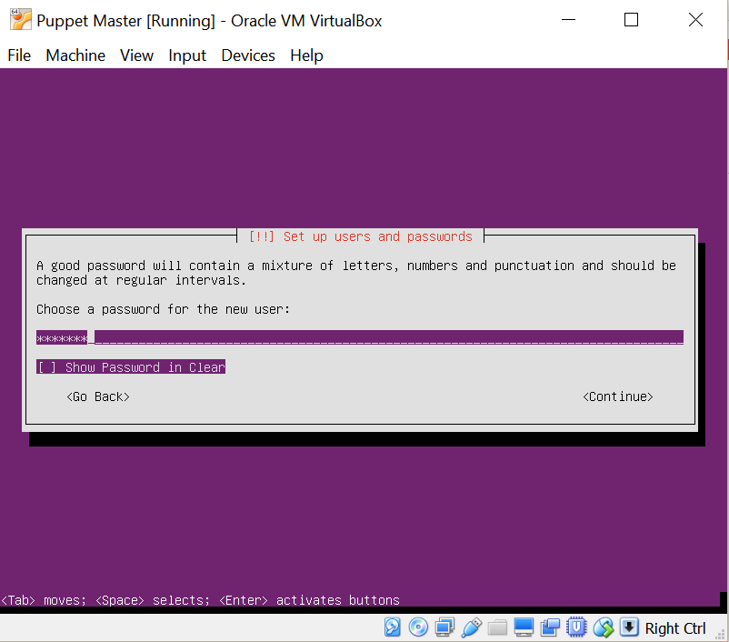
Choose a Password
Type a user name
Tab to Continue and Press Enter
Retype Password and Press Enter

Slide 43
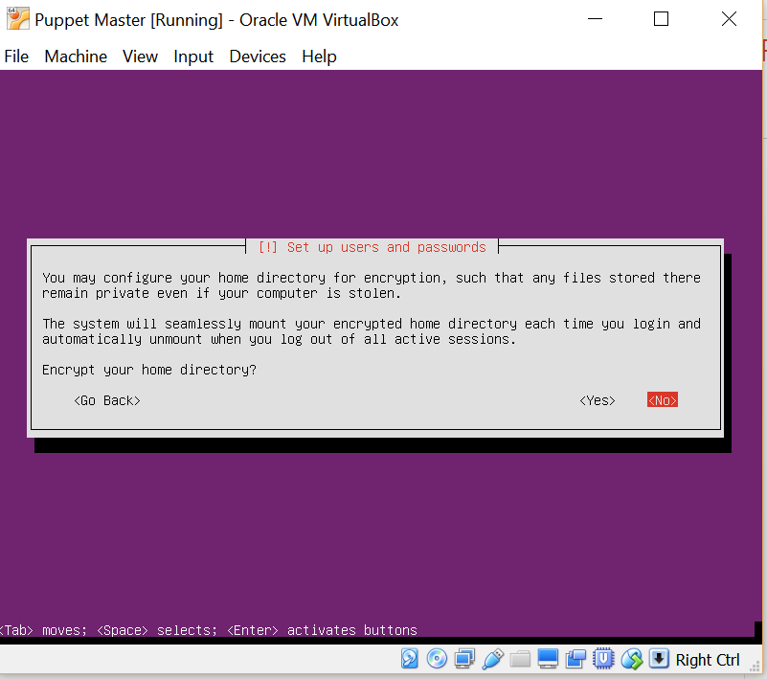
Select No Encryption

Slide 44
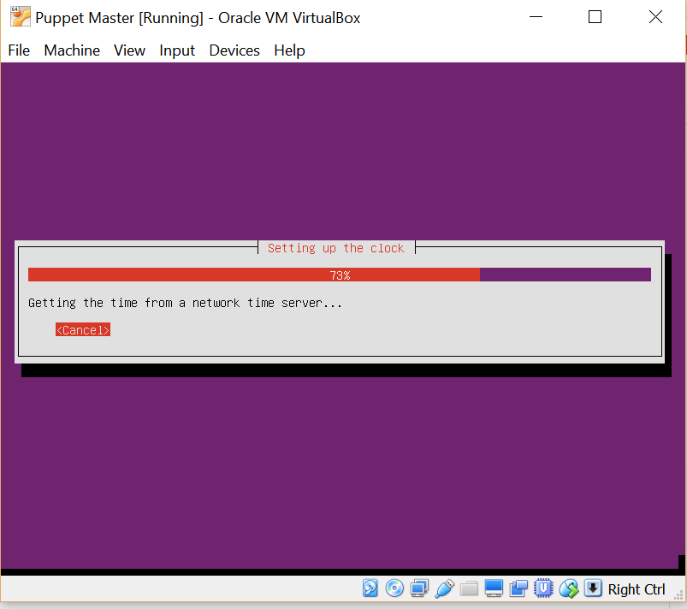
Selecting Time and Clock

Slide 45
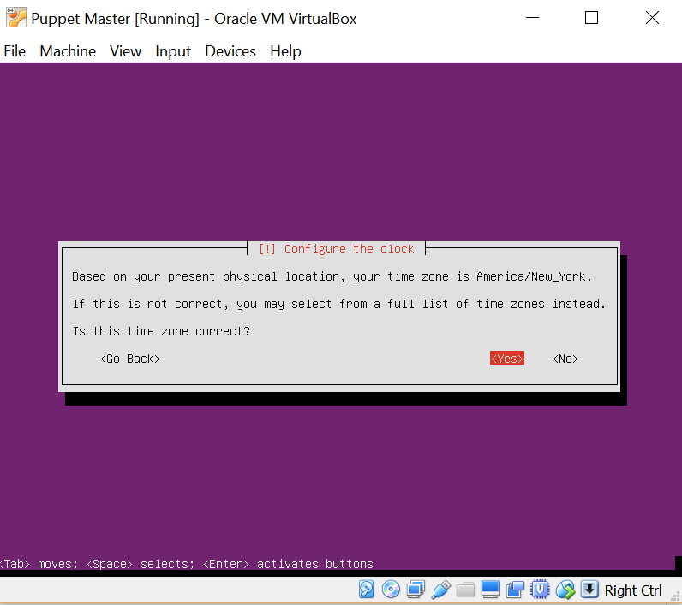
Select Time Zone

Slide 46
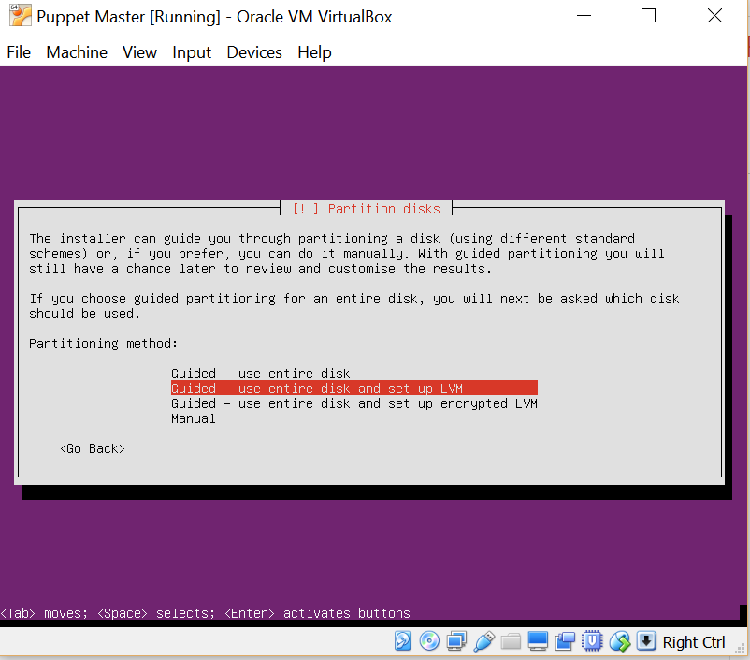
Use Hard Disk

Slide 47
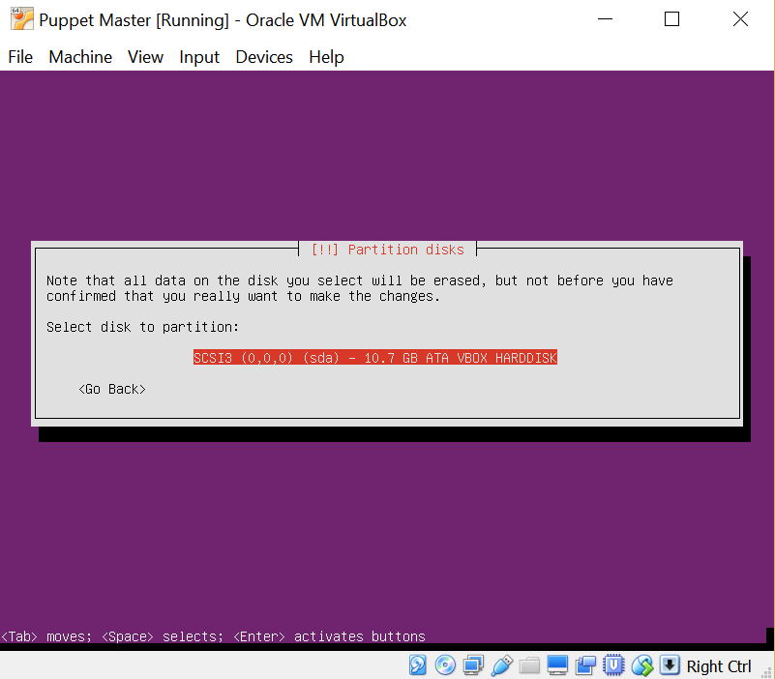
Select hard Disk

Slide 48
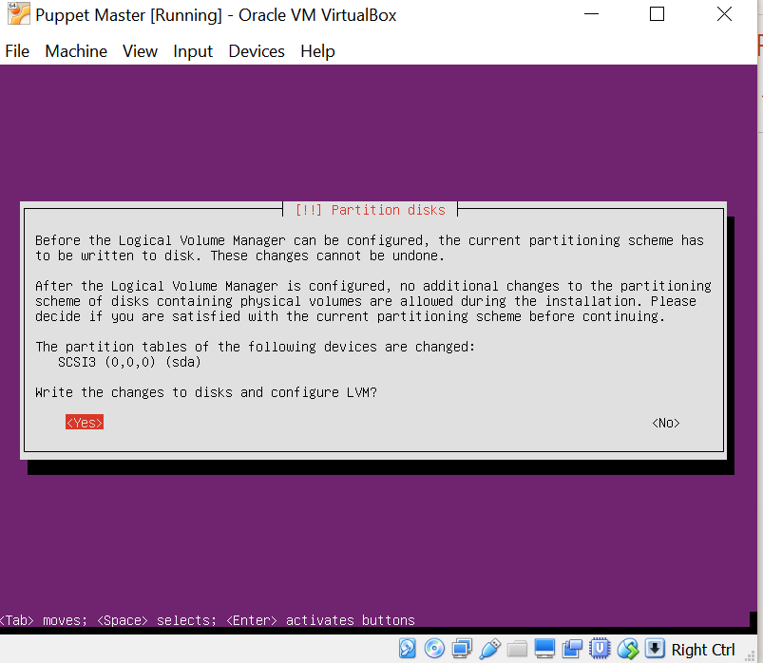
Write Changes to Disk
Tab to Yes and Press Return

Slide 49
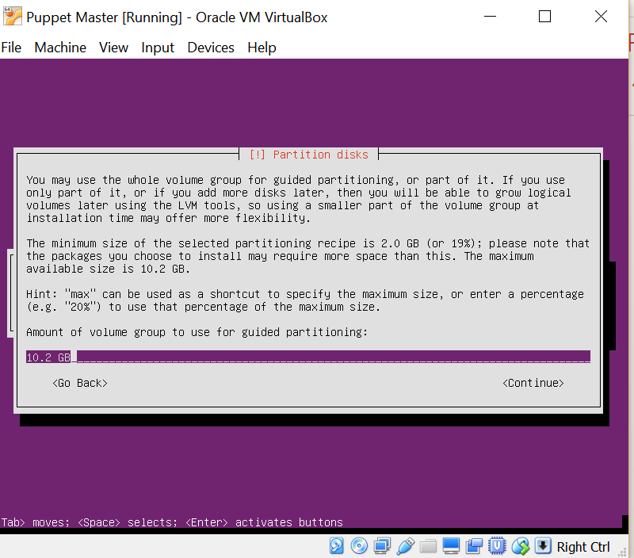
Choose Default

Slide 50
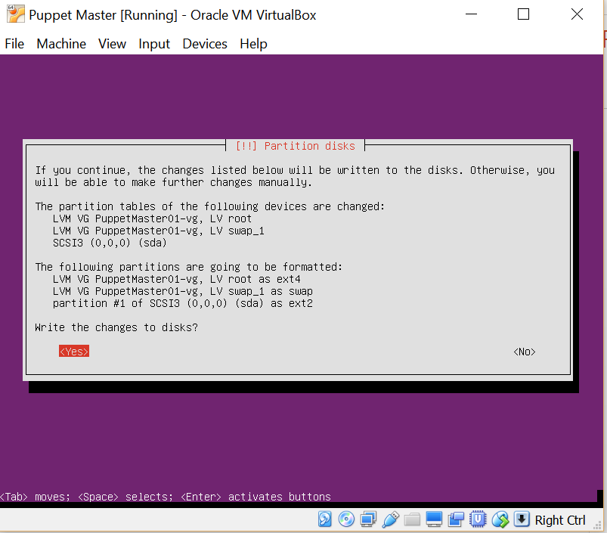
Commit Changes to Disk
Tab to Yes and Press Return

Slide 51
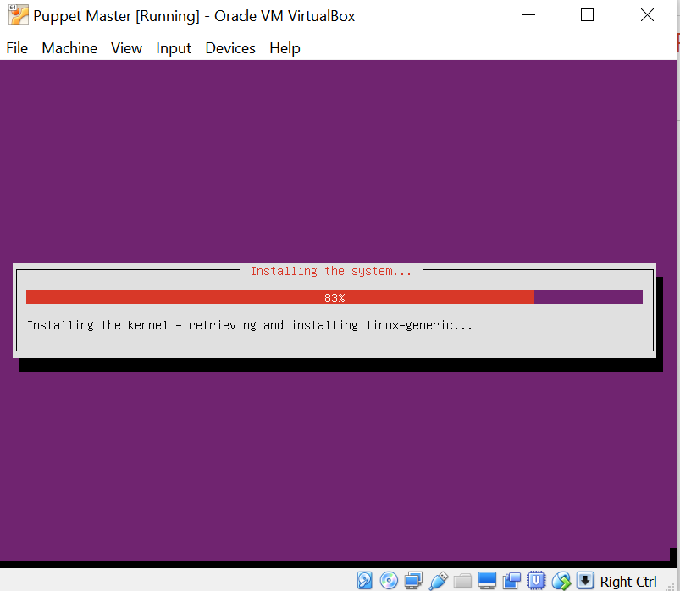
Installing OS

Slide 52
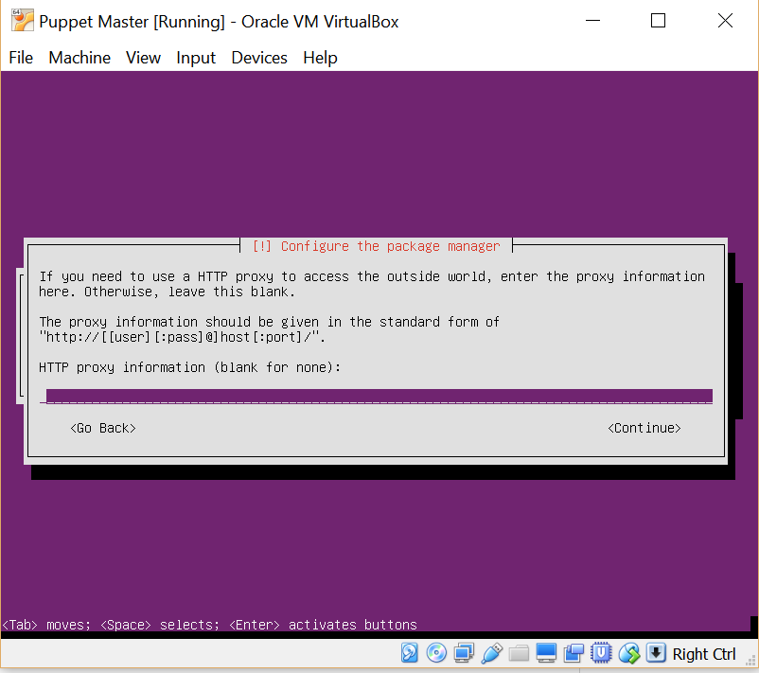
Proxy – Choose Default No Proxy

Slide 53

Configuring…

Slide 54
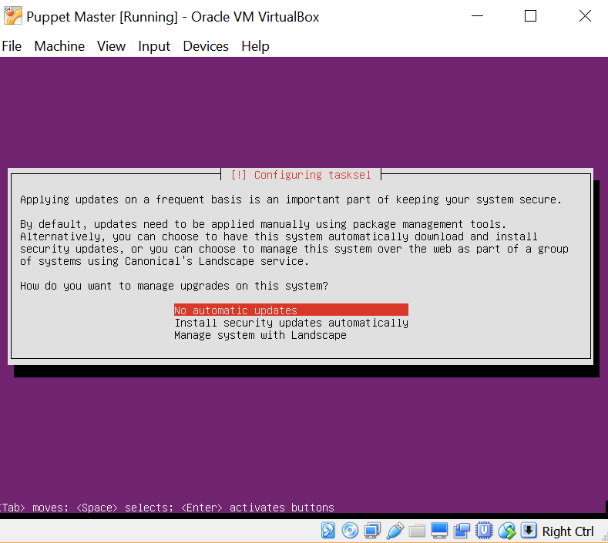
Choose Default for Updates

Slide 55
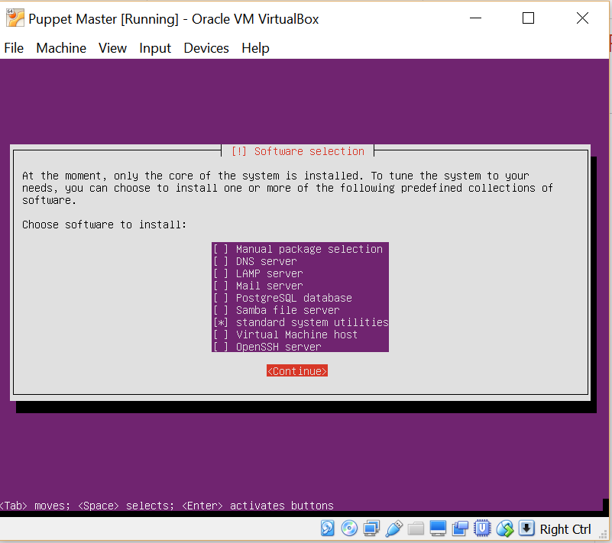
Choose Default Packages

Slide 56
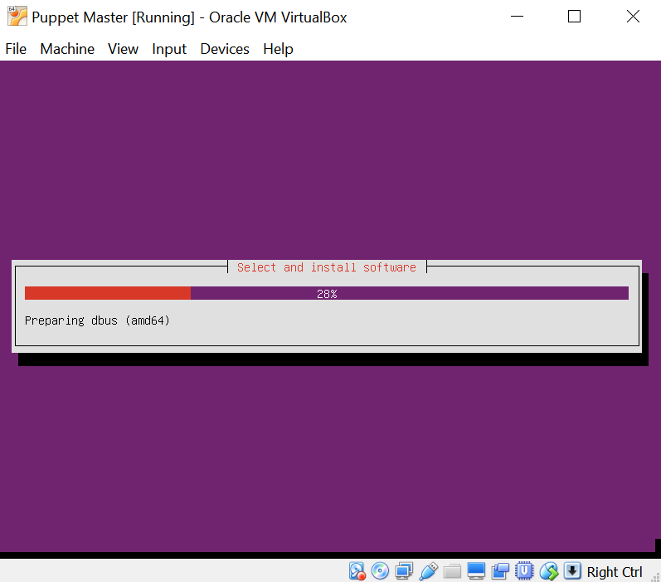
Package Installation

Slide 57
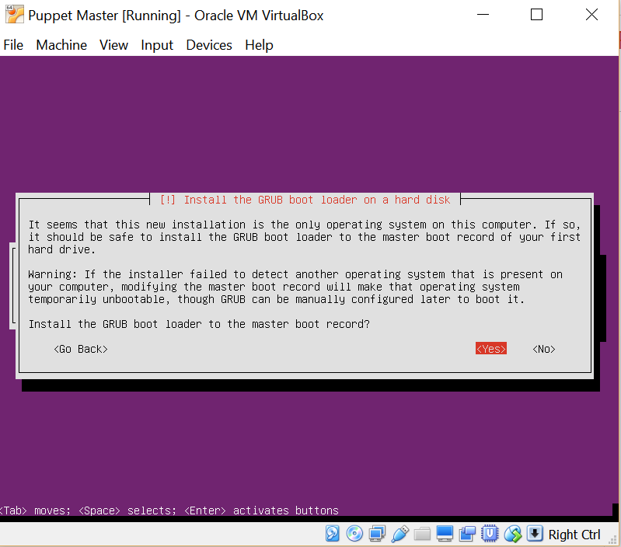
Grub Installation - Yes

Slide 58
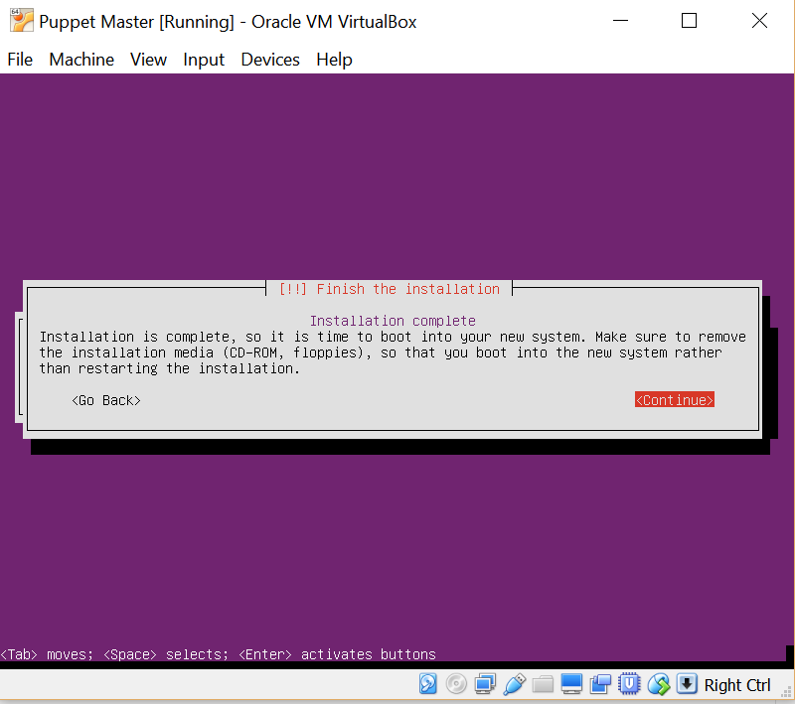
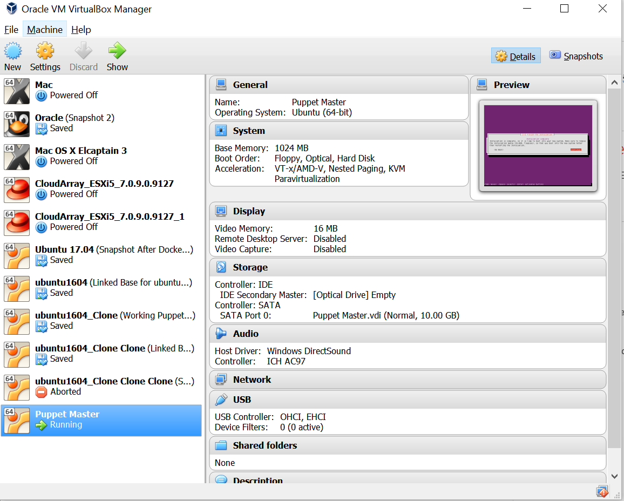
Installation Completed - Reboot
Prior to rebooting, verify that the ISO image has been removed from the virtual DVD drive. If not, detached from the drive. Otherwise the installation process will start all over. When rebooted.

Slide 59
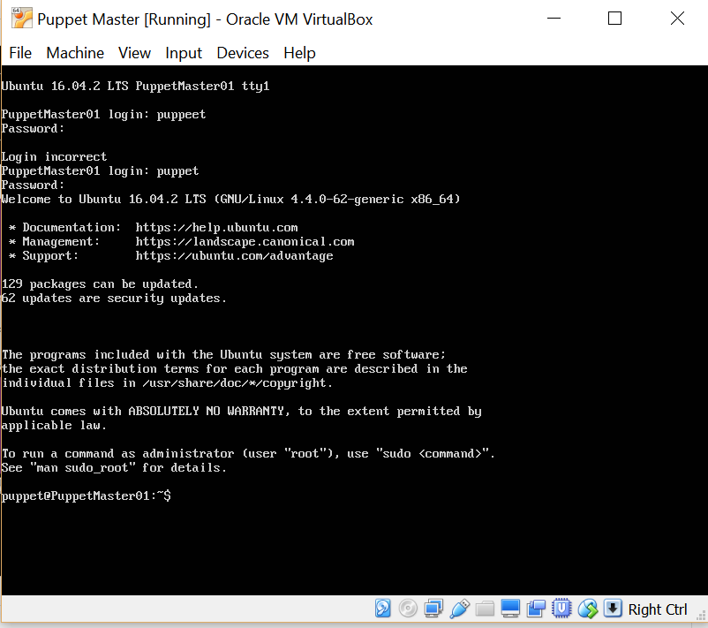
Login New VM
Login into the new VM with the user name and password that was created during the Ubuntu installation process.
To add a graphical Desktop run the following commands once logged in
sudo apt-get update
sudo apt-get install ubuntu-desktop

Slide 60
Session Summary
Installed VirtualBox
Installed 2 VMs
Puppet Master
Puppet Client
Installed Ubuntu in the 2 VMs
Tested the Ubuntu installation by logging into each.

Slide 61
Questions?

Slide 62
Thank You

